Slide 1
BitHub, Everywhere, Worldwide
December 7, 2019

Slide 2
Welcome!
Raise your hand if…
this is your first hackathon!

Slide 3


How do I check-in?
1
2
Check-in System
A local organizer must check you in through the MLH system to participate in the event.
Check your Email
Once you’re checked in, you’ll receive an email with your Slack invite & the day-of materials.

Slide 4

So, what exactly is Local Hack Day: Build?
A learning-focused 12 hour hackathon
200+ global events on the same day
Hacking, activities, networking, & more

Slide 5


Wifi Network:
[prime]
Wifi Password:
[Password]
Event Hashtag:
#LocalHackDay
Twitter Handle:
@MLHacks

Slide 6

Today’s Schedule
8:00am - Check-in Begins
9:00am - Opening Ceremony
9:30am - Hacking Begins
1:00pm - Lunch Break
2:00pm – Hacking Continues
4:00pm - Break
4:30pm - Hacking Ends / Demos Start
6:10pm - Awards & Event Ends

Slide 7
Write down this URL!
Find everything you need for Local Hack Day!
lhd.mlh.io/live

Slide 8



Watch the
Opening Ceremony
lhd.mlh.io/video

Slide 9

Stay Connected!
?
We’re using a platform called Slack to connect hackers, provide tech support, & share announcements
Need help? Reach out to Microsoft mentors and ask questions and get help with your project
lhd.mlh.io/slack
#ask-microsoft

Slide 10



APIs & Resources
Get access to domains, SSL certificates, 24/7 mentors, free GitHub, & more repos on the GitHub Developer Pack!
Claim your own dot com domain name through Name.com courtesy of our friends at Verisign!
Our friends at Microsoft are giving everyone $100 in Azure credit! Use it for hosting, machine learning, & more!
lhd.mlh.io/github
lhd.mlh.io/domains
lhd.mlh.io/azure

Slide 11

Global Prize Categories
MLH will award prizes to the top 3 in each category
Best Use of Microsoft Azure
Best Open Source Project on GitHub
Best .COM Domain Name from Verisign

Slide 12
Submit your project lhd.mlh.io/devpost
Create your project page
Submit to Devpost and pick your prizes
You can always update your project page

Slide 13
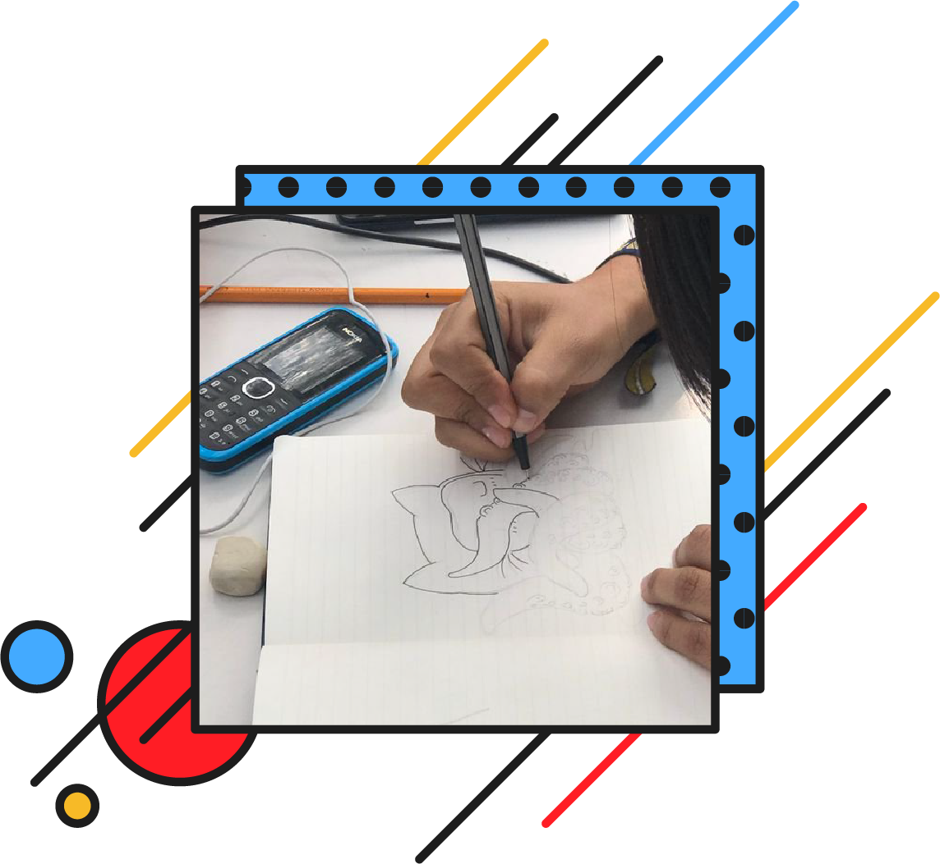


Social Contest: #MyOctocat
Are you feeling artistic? Draw your own version of GitHub’s adorable mascot and you could win a t-shirt or other swag! Your entry can be hand-drawn or digital and winners will be selected the week after Local Hack Day!
To Enter: Tweet what you made at @MLHacks & @GitHubEducation along with #MyOctocat & #LocalHackDay #bitHubPh.

Slide 14

Photo Contest: Best LHD Photo
Share your Local Hack Day photos with the worldwide community on Social Media. We are running a Local Hack Day photo contest where we will be selecting some of the best photos from the event. Show off what your community looks like and be creative!
To Enter: Share your photo on Twitter or Instagram and tag @MLHacks with the hashtag #LocalHackDay #bithubPh.

Slide 15
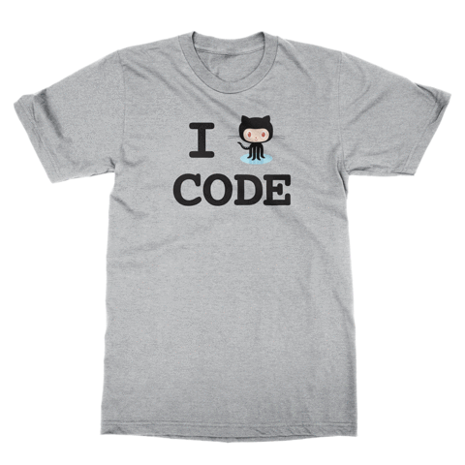
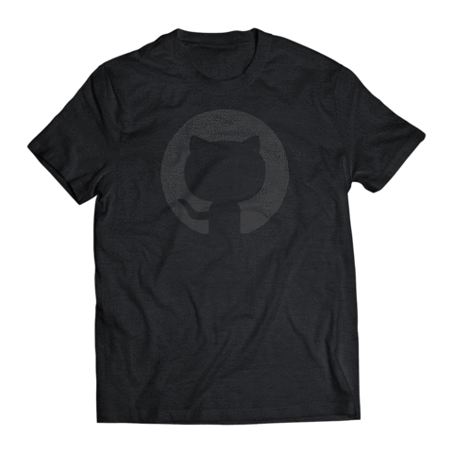
Slack Raffles
Win Swag & Prizes on Slack!
You can also win prizes & swag by participating in Slack Raffles. Throughout the weekend, we’ll be posting questions in Slack and raffling off t-shirts, credit, & more to people who respond.

Slide 16
Code of Conduct
At MLH, we believe that hackathons should be safe & welcoming spaces. That’s why this event, and every MLH event, uses the MLH Code of Conduct.
mlh.io/code-of-conduct

Slide 17






Thanks to our sponsors!
& our partners!
Notes:
Fish Icon = Glitch

Slide 18
Local Partners & Sponsors
Help us thank all the sponsors & partners who made this day possible!

Slide 19
Forgot something?
Find everything you need for Local Hack Day!
lhd.mlh.io/live

Slide 20
Thanks for joining us! Build something awesome today.

